Slide 1




The Task Parallel Library Not only Multithreading But Also Async Programming
From Anish Jain

Slide 2
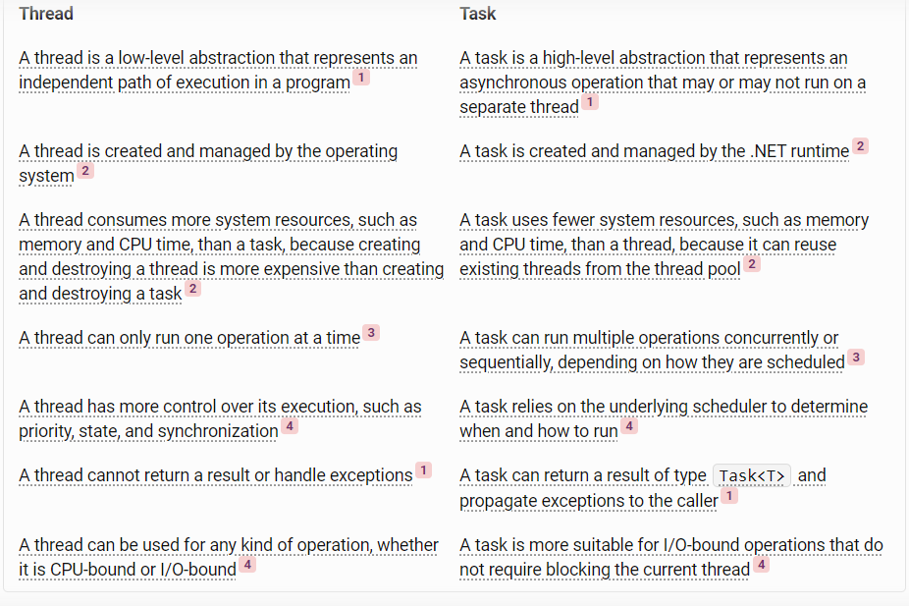
Thread vs Task

Slide 3
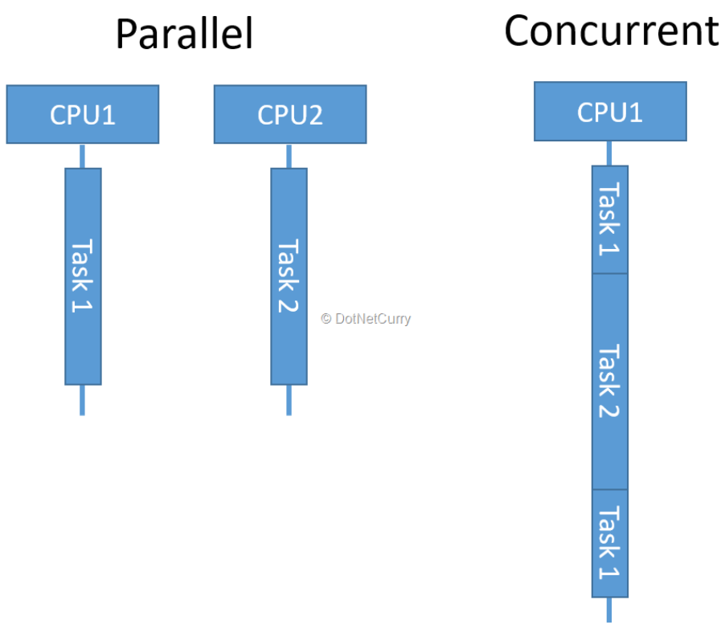
Asynchronous Defined
Concurrent
Multithreaded
Parallel
Asynchronous

Slide 4

Concurrent | Multithreaded | Parallel | Asynchronous
Concurrent programming is about the interleaving of multiple tasks within a single process or thread1. It does not necessarily imply parallelism or asynchrony. | Multithreaded programming is about creating and managing multiple threads within a single process. Each thread can run a different task concurrently, but may or may not run in parallel depending on the number of CPU cores. | Parallel programming is about executing multiple tasks simultaneously on multiple CPU cores. It is a form of concurrency that exploits the parallelism of hardware. | Asynchronous programming is about initiating multiple tasks without waiting for each one to complete. It does not necessarily imply concurrency or parallelism, as the tasks may run on the same thread or different threads.
Concurrent programming can improve the responsiveness and scalability of an application by allowing it to handle multiple requests or events without blocking. | Multithreaded programming can improve the performance and responsiveness of an application by utilizing the CPU resources more efficiently, especially on multi-core processors. | Parallel programming can improve the performance and throughput of an application by reducing the execution time of CPU-bound tasks. | Asynchronous programming can improve the responsiveness and scalability of an application by avoiding blocking the current thread while waiting for I/O-bound tasks.
Concurrent programming can introduce challenges such as race conditions, deadlocks, and resource starvation when multiple tasks access shared data or resources. | Multithreaded programming can introduce challenges such as thread safety, synchronization, and context switching when multiple threads access shared data or resources. | Parallel programming can introduce challenges such as load balancing, data partitioning, and communication overhead when multiple tasks run on multiple cores. | Asynchronous programming can introduce challenges such as error handling, callback hell, and debugging when multiple tasks run without blocking.
Concurrent programming can be implemented using various techniques such as coroutines, generators, actors, message passing, etc2. | Multithreaded programming can be implemented using various classes and methods in the System.Threading namespace such as Thread, ThreadPool, Monitor, Mutex, etc3. | Parallel programming can be implemented using various classes and methods in the System.Threading.Tasks namespace such as Task, TaskFactory, Parallel, etc. | Asynchronous programming can be implemented using various classes and methods in the System.Threading.Tasks namespace such as Task, TaskCompletionSource, Task.Run, etc. It can also use keywords such as async and await to simplify the code.

Slide 5
Let's start with TASK

Slide 6
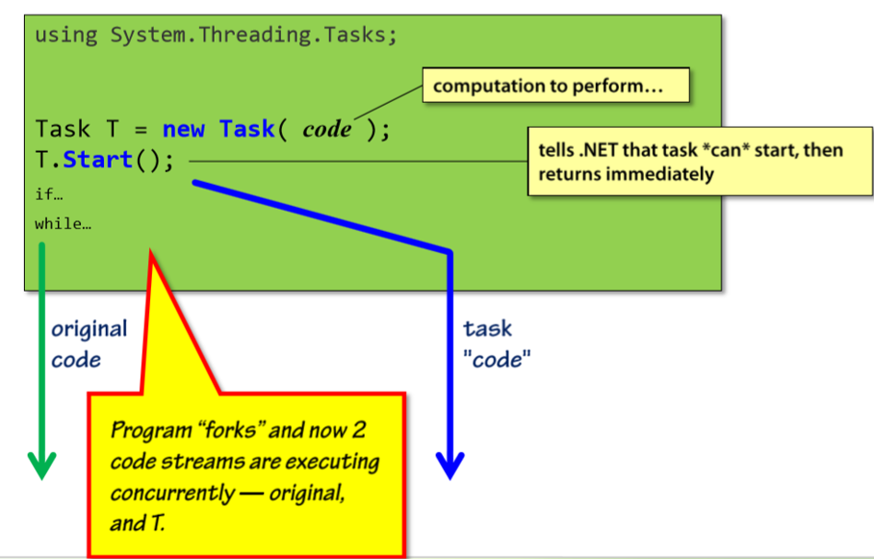
Creating Task

Slide 7
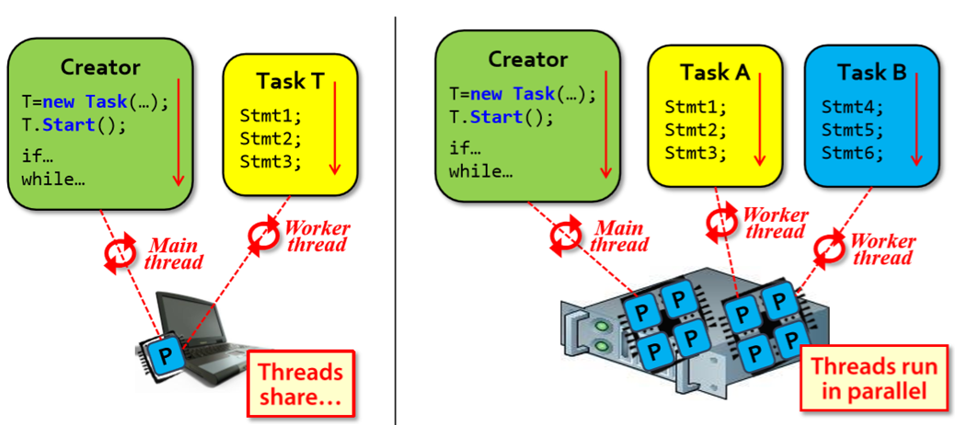
Execution model - a quick look
Code-based tasks are executed by a thread on some processor
Thread is dedicated to task until task completes

Slide 8
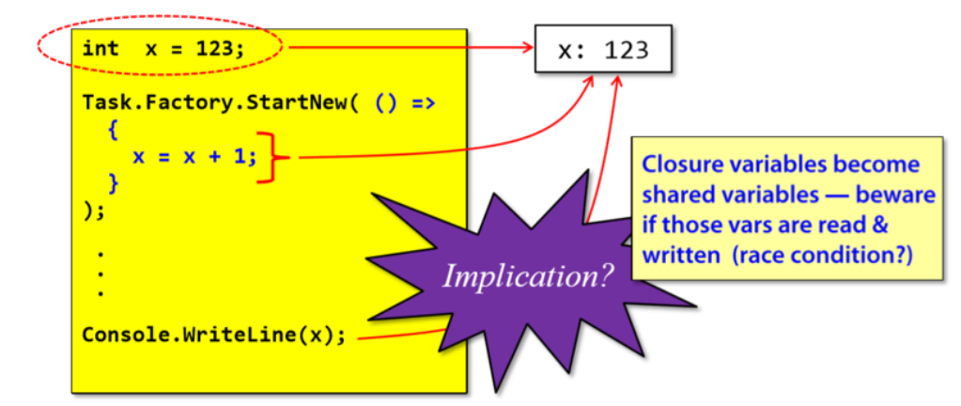
Closure Variables
How are closure variables passed?
Think "By REFERENCE"

Slide 9
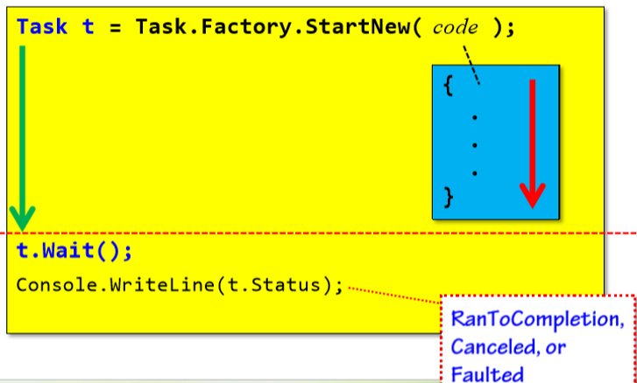
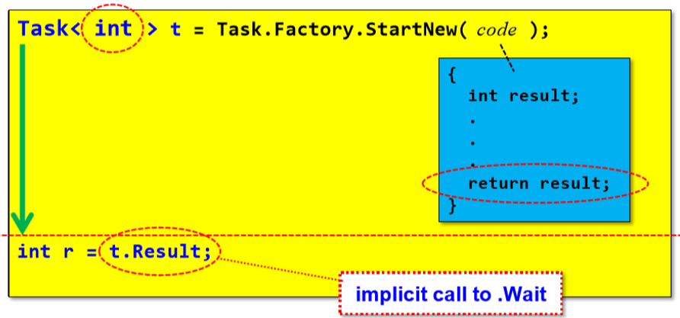
Harvesting results

Slide 10
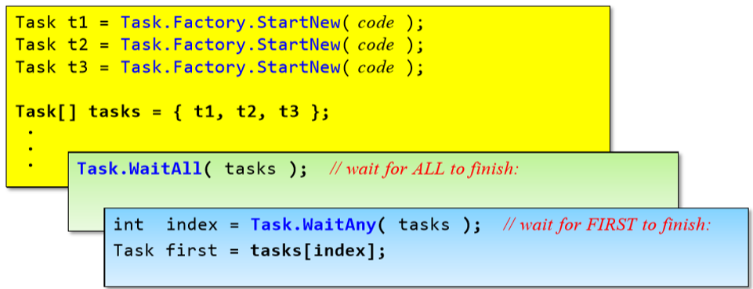
Waiting on multiple task
What's the best way to wait for a *set* of tasks to finish?
- Calling. Wait on each task implies an ordering that might not hold
What's the best way to wait for the *first* task to finish?
- e.g parallel search of multiple sites, first one wins

Slide 11
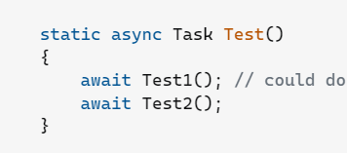
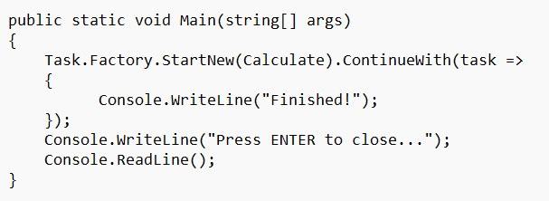
Are you using ContinueWith in your async code? If yes? Why?
1. Allocates another task per operation (it wraps your delegate in a task object) instead of re-using the state machine.
2. ContinueWith allocates more than using async await.

Slide 12
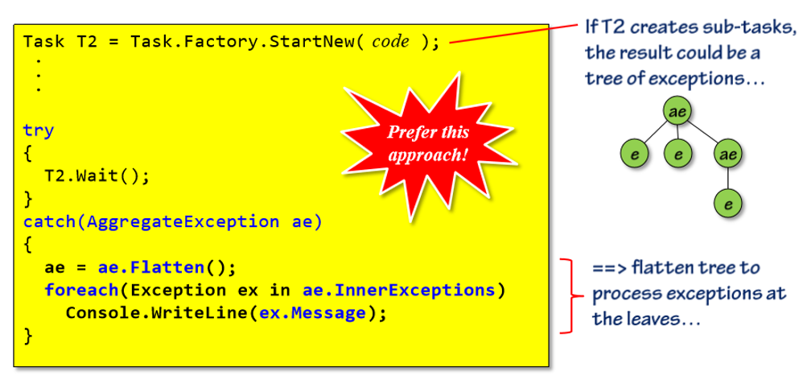

Exception Handling

Slide 13
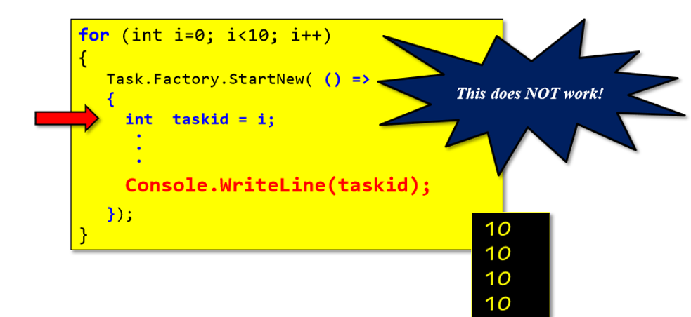
Example 1

Slide 14
Let's start with ASYNC-AWAIT

Slide 15
What is our goal?
Do more with less
Juggle more users

Slide 16

Sync (blocking)
A customer arrives with clothes
You put the clothes in the machine
You sit in front of the machine until they are done
You take the clothes back to the front desk
You can now serve the next customer

Slide 17
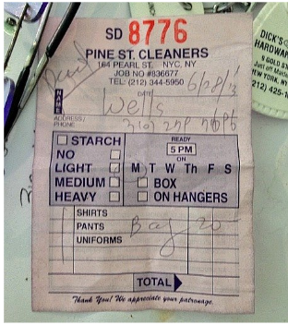
Async (non-blocking)
A customer arrives with clothes
You take their phone number and give them a ticket
You put the clothes in the machine
You go back to the desk to help the next customer
When the clothes are done, you call the first customer

Slide 18
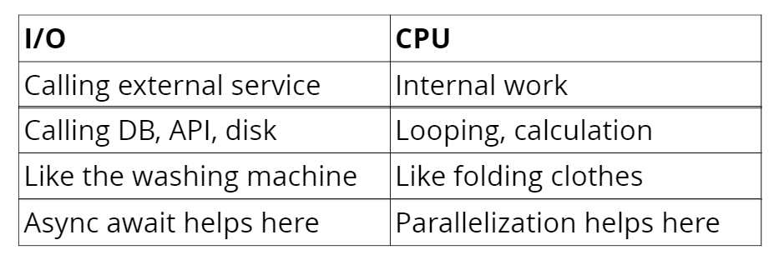
I/O vs CPU

Slide 19
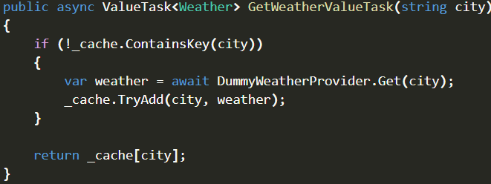
Value Task
Represent both synchronous and asynchronous operations.
Hold the result directly without any heap allocations
If the operation is not yet completed, ValueTask can switch to using a Task internally, but only if necessary
When to use it?

Slide 20
Configure Await (true/false)
It tries to resume the execution on the same context after the task is completed.
To avoid these problems, ConfigureAwait can be called with a false argument, which tells the awaiter that it does not need to resume on the original context, and can run the continuation on any available thread or context
However, using ConfigureAwait(false) can also introduce some risks, such as losing access to UI elements or HttpContext, or causing unexpected parallelism or thread-safety issues
Therefore, it is recommended to use ConfigureAwait(false) only when the code does not depend on the original context, and to use the default ConfigureAwait(true) otherwise

Slide 21
IAsyncEnumerable<T>
It iterate over a collection of elements asynchronously.
It uses the MoveNextAsync method
This means that you can use the await keyword to wait for the next element to be available, without blocking the current thread.
you can process the elements as they are produced

Slide 22
Best Practice
Avoid async void methods.
Async all the way
Async library methods should consider using Task.ConfigureAwait(false) to boost performance
Let the async flow. Use await not .Result to get the result of a task.

Slide 23
References
https://medium.com/@joni2nja/why-you-should-not-use-continuewith-in-your-async-code-c9eaf6087e64
https://learn.microsoft.com/en-us/dotnet/standard/parallel-programming/exception-handling-task-parallel-library
https://stackoverflow.com/questions/271440/captured-variable-in-a-loop-in-c-sharp
https://slides.com/tomdane/async-await-old/fullscreen#/28/0/4
https://github.com/dotnet/core/issues/7011

